Slide 1
Memory Management

Slide 2
The Memory Hierarchy
    Memory management deals primarily with main memory and its relation to secondary memory. The OS moves programs between disk and main memory.
    The cache is managed by the hardware.
    The disk is managed by the file system and the I/O system.
More capacity, slower, cheaper
Cache
Main Memory
Secondary Memory
(disk)

Slide 3
Main Memory Characteristics
Memory is seen as a linear array of addressable locations (bytes or words).
Main memory is random access: all locations are equally accessible (same amount of time).
The logical (virtual) address space of a computer may be larger than the amount of physical memory.

Slide 4
Main Memory Characteristics
Executing one instruction may require several memory accesses: one to fetch the instruction, one or more to fetch operands or store results.
Memory access time >>> CPU time
Hence it is important to limit the number of memory accesses. Caching is a hardware technique to speed up memory references.

Slide 5
What Is Memory Management? (MM)
In uniprogramming, main memory was divided in two parts:
    the currently executing program
    an OS kernel that provides services to the program
In multiprogramming there are many processes (even in a single-user system).We need to accommodate as many of these processes in memory as possible.

Slide 6
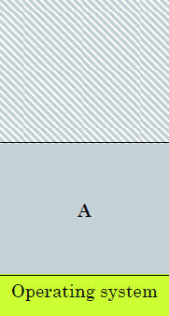
Single Process System
Memory management simple
OS gets a fixed part of memory
One process executes at a time
Process is always loaded at address 0
Maximum address is total memory size (minus) OS size
Limited in capability
UNUSED SPACE
Process
Notes:
Process loaded into free space in work area

Slide 7
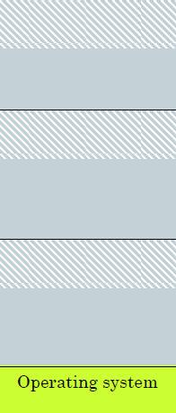
Multiple Process Memory
Divide memory into number of separate fixed areas
  OS occupies one area
Each can hold one processes
  Memory is wasted if process is smaller than partition
  Internal Fragmentation
Prevent a process being run
  If there isn't a partition big enough
UNUSED SPACE
Process A
UNUSED SPACE
Process B
UNUSED SPACE
Process C

Slide 8
What Is Memory Management?
Performance is poor if the OS has to load a process each time it is scheduled.
Performance is improved if there are many processes in memory so there are always runnable processes when the CPU is idle.
Memory needs to be allocated efficiently in order to pack as many processes into memory as possible.

Slide 9
What is Memory Management?
MM is the task of storing and managing multiple processes in main memory. It is carried out by the OS, with support from the hardware.
Memory is divided into kernel space and user space, to accommodate both the kernel and user processes. MM is concerned with managing user space.

Slide 10
Objectives of MM
Support a high level of multiprogramming
  efficient management of user space
Keep the overhead of MM to a minimum
  MM data structures shouldn’t take a lot of kernel space
  MM operations shouldn’t add a lot of time
  MM shouldn’t incur additional memory references (references = time)

Slide 11
Requirements for Memory Management
Relocation
Protection
Sharing
Logical Organization
Physical Organization

Slide 12
Memory Management Requirements
Relocation
  The translator does not know where the program will be placed in memory when it is executed
  Furthermore, a process may be swapped in and out of memory, so it will occupy different physical locations at different times.
  Consequently, the translator cannot assign physical addresses to the instructions and data - it must assign logical (or virtual) addresses.

Slide 13
MM Requirements
Relocation (continued)
  On the other hand, once programs are loaded, the processor and OS must be able to reference the actual physical addresses at which the code and data are stored.
  Relocation is the process of converting a logical address to a physical address. Its purpose is to let a program be executed from different areas of main memory at different times.

Slide 14
MM Requirements
Protection
  Program address space includes process control information (the PCB), program code, data segment (for global data), stack/heap space, and possibly other elements such as shared memory.
  This information may or may not be stored in contiguous locations, but it can be visualized as a linear sequence of addresses.

Slide 15
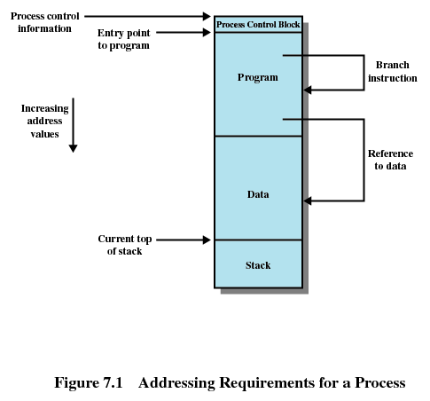

Slide 16
MM Requirements
Protection (continued)
  Processes must not reference memory locations in another process without permission.
  It’s impossible to check address references at compile time; actual addresses aren’t available
  So how do you know if one process is referencing the address space of another?
  Address references must be checked at run time by hardware; software checks are too slow.

Slide 17
MM Requirements
Sharing
  Sometimes, processes must be allowed to share common areas of memory:
    Several processes executing the same program (e.g., an editor). Memory usage is more efficient if all processes share a single copy of program code. Transparently managed by the OS.
    Cooperating processes (e.g. producer/consumer) need to access shared data structures. This sharing must be explicitly requested by processes.

Slide 18
MM Requirements
Logical Organization
  While main memory is a linear address space, programs are often organized as modules of different types. The structure may be hierarchical.
  Some modules are code modules (execute only); some are data (read-only or read-write); some are private; some may be shared.
  The OS should support this organization.

Slide 19
MM Requirements
Physical Organization
  Primary memory is fast and expensive.
  Secondary memory is slower and cheaper.
  Consequently, computer systems usually have small amounts of main memory and large amounts of disk storage.
  The OS must be responsible for moving information between the two levels.
  This is a vital part of memory management.

Slide 20
MM Requirements
Physical Organization (continued)
  An executing program gets a certain amount of memory. What to do if it isn’t enough?
  Programmer-managed overlays where the programmer organizes code into modules that can be swapped in and out of memory, or …
  OS-managed virtual memory system

Slide 21
Memory Partitioning
Definition of partitioned memory management
Issues in partitioning
Partitioned allocation schemes
  fixed partitions
  dynamic partitions

Slide 22
Partitioned Memory Management
Early MM systems had the following requirements for a process to execute:
  The entire process image must be in memory
  The process image must be loaded into consecutive (contiguous) memory locations
Since only a few processes fit in memory at a time, OS must use swapping: swap out a blocked process, swap in a ready process

Slide 23
Partitioning
A partition is a set of contiguous locations in physical memory, designed to hold a single process.
Partitions may be
  fixed (static, predetermined size) or
  dynamic (allocated dynamically so that each partition is the size of the process it holds)

Slide 24
Issues for Partitioned Systems
Fragmentation
  a condition in which small blocks of unusable memory are created, either within a partition (internal) or between partitions (external)
Placement
  where should a particular process be placed? If there are multiple partitions available, how is one chosen?

Slide 25
Issues (continued)
Replacement
  If all processes are blocked, it may be desirable to swap out one or more to make room for a new process or one in the ready-suspend state. How do you decide which one(s) to swap?
Free space management
  How does the system know which blocks of memory are free (not assigned to a process)?

Slide 26
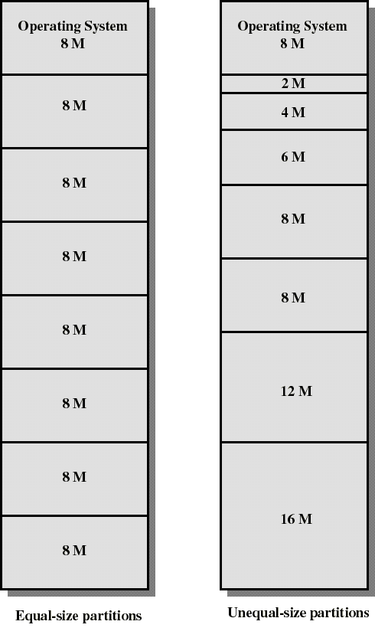
Fixed Partitioning
Partition main memory into a set of non- overlapping areas or partitions
Partitions can be of equal or unequal sizes
The size is usually determined at system configuration

Slide 27
Fixed Partitions
A program may be too big for any partition.
Internal fragmentation is significant. Unequal-sized partitions can make the problem less severe, but cannot do away with it.
Placement is trivial for fixed-size, but can be done in one of two ways for variable sizes.

Slide 28
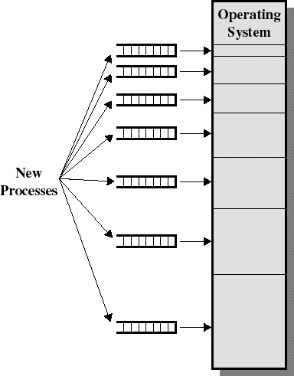
Placement Algorithm - Fixed
Multiple queues
  assigns processes to the “best fit” partition
  separate queue for each partition size
  tries to minimize internal fragmentation
  Some queues will be empty if there are no processes for that size range. This may mean a smaller process will wait in another queue even if space is available.

Slide 29
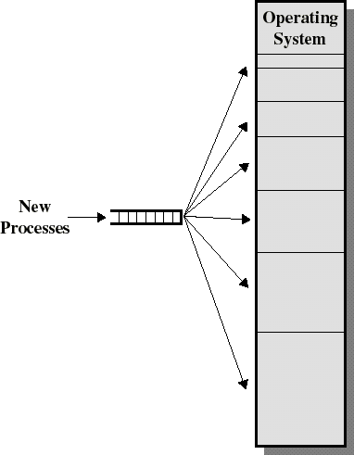
Placement Algorithm - Fixed
Single queue
  When it’s time to load a process into main memory, the smallest available partition that will hold the process is selected
  No danger that a process will wait in one queue while space is present in another

Slide 30
Fixed Partitions - Summary
Not very flexible:
  If a program is larger than any partition, it must be run using user-managed overlays
  the maximum level of multiprogramming (number of processes in memory) is limited to the number of partitions
  excessive internal fragmentation and swapping.

Slide 31
Dynamic Partitioning
Size, number, and placement of the partitions is determined dynamically as processes are created and destroyed.
When a new process is created, a partition is created from a block of free space. The partition is designed to fit the process.
Dynamic partitioning is more complex than fixed partitioning.

Slide 32
Fragmentation in Dynamic Partitioning
Initially new processes will be assigned adjacent partitions so there is no fragmentation.
Eventually, as processes leave or are swapped out, and their partition is reallocated, “holes” will develop. This is external fragmentation.

Slide 33
Fragmentation
Internal fragmentation is not a problem in dynamically partitioned MM.
External fragmentation may be handled by compaction. Processes are moved to one end of memory so all are contiguous. Free space is coalesced into a single larger hole.
Compaction is time consuming.

Slide 34
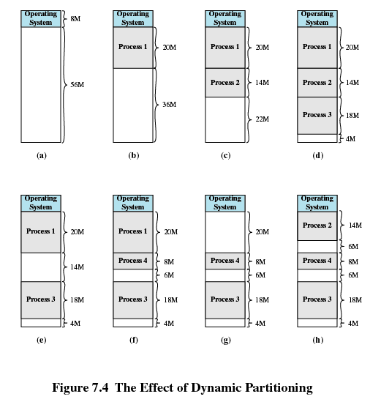

Slide 35
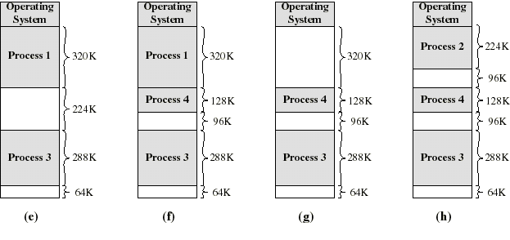
Dynamic Partitioning: an example
The OS swaps out Process 2 (e) to bring in Process 4 (f), creating a 96K hole. In (g), the OS swaps out Process 1 to bring in Process 2 again; another hole of 96K is created.
Compaction would produce a single hole of 256K

Slide 36
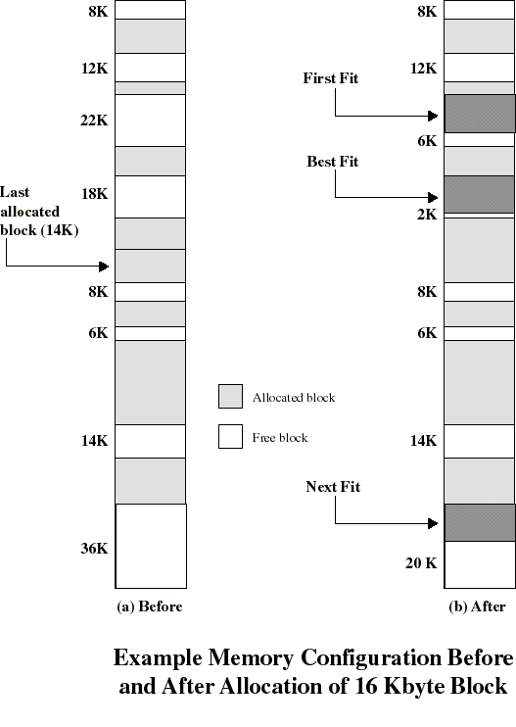
Placement
Goal: reduce need for compaction
Possible algorithms
  best fit: choose smallest hole
  first fit: choose first hole (that fits) from beginning
  next-fit: choose first hole from last choice
Placement isn’t an issue with fixed partitions

Slide 37
Placement Algorithm: Observations
First-fit: easy, usually the fastest and best.
Next-fit: slightly worse, often leads to allocation from the largest block at the end of memory
Best-fit: usually the worst. The fragments it creates are the smallest possible, least likely to be useful. Compaction generally needs to be done more often than with other schemes.

Slide 38
Replacement Algorithms
  When all processes in main memory are blocked, the OS can swap in a suspended-ready process, if one exists.
  The OS must choose which process to replace (swap out or suspend) to make room for the incoming process.
  Considerations: state (blocked or ready), size (relative to process being swapped in), priority, ...
  Later we will discuss replacement algorithms for virtual memory management schemes.

Slide 39
Free Space Management
The OS must maintain some kind of free space list to support allocation.
For fixed partitions, this is easy - just have a list with one entry for each partition.
For variable partitions, the process is more complicated. A free list will have an entry for each “hole” in memory, but every allocation or deallocation will change the list.

Slide 40
Relocation
Swapping and compaction may cause a process to occupy different main memory locations during its lifetime.
Hence physical addresses in programs cannot be permanently assigned.
This problem is solved by distinguishing between logical and physical addresses.

Slide 41
Address Types
A physical address or absolute address refers to a physical location in main memory.
A logical address is a reference to a memory location “independent of the current assignment of data to memory.” (Stallings)
Compilers produce code in which all memory references are expressed as logical addresses.
A relative address is a kind of logical address in which the address is expressed relative to some known point in the program. Usually, the first location is address zero and all other addresses are offsets from this address.

Slide 42
Address Translation
Programs are loaded in main memory with all memory references in relative form
Physical addresses are calculated “on the fly” as the instructions are executed. This process is called address translation, or address mapping.
For adequate performance, the translation from relative to physical address must by done by hardware.

Slide 43
Hardware Address Translation in Partitioned Memory Systems
When a process is dispatched, a base register (in the CPU) is loaded with the physical start address of the process and a bounds register is loaded with the process’s ending physical address.
When a relative address is encountered, add it to the contents of the base register to get the actual physical address.
The physical address is then compared to the bound register to make sure the process isn’t referencing a location outside its own address space.
The hardware mechanism provides translation and protection.

Slide 44
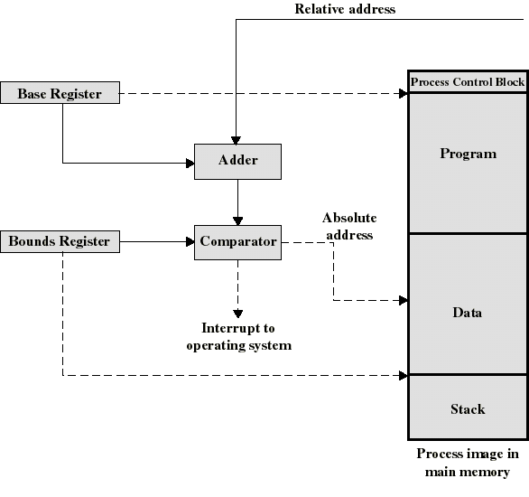
Hardware for Address Translation

Slide 45
Address Translation
The base-and-bounds approach supports dynamic relocation, as well as protection and translation, since each time the process is dispatched the registers can be loaded with the appropriate values.
However, it works only if the process image is loaded into consecutive memory locations.

Slide 46
Summary
Main purpose of memory management: keep enough processes in memory to keep the CPU busy – requires efficient memory allocation methods.
Partitioned allocation methods: not flexible
  Entire process address space must be in memory
  Process address space must be stored in consecutive locations

Slide 48
Memory Management II
Simple Paging

Slide 49
Partitioned MM Summary
Partitioned memory systems assume:
  entire process address space will be in memory
  address space will be loaded in contiguous locations.
Result: less than optimal use of memory:
  significant fragmentation (internal or external)
  requirement to load entire program means space may be wasted on unused code and data.

Slide 50
Partitioned MM Summary
Poor use of memory leads to poor performance:
  may need to use compaction and/or swapping to load processes when CPU is idle.
  large programs may not fit into memory, forcing programmer to use manual overlay techniques
Relaxing assumptions may help.

Slide 51
Non-Contiguous Storage
Relaxing the assumption that process address space will be stored contiguously will let the MM system utilize memory better.
If portions of processes can be loaded in separate areas of memory, compaction will not be necessary.

Slide 52
Simple Paging
Paging assumes that memory is divided into fixed-size chunks, called page frames.
Process address space is divided into chunks called pages.
Pages are the same size as frames, so a page can fit into any free space of memory.
No external fragmentation.
Internal fragmentation = 1/2 page/process.

Slide 53
Simple Paging
Simple paging isn’t used by itself, but it’s the basis of virtual memory.

Slide 54
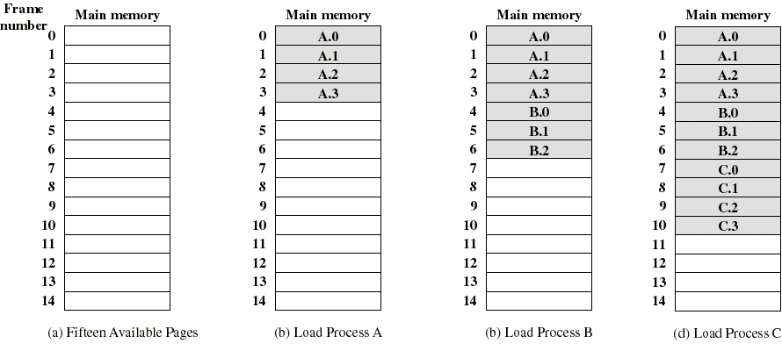
Example of process loading
Processes A, B, and C are loaded into memory in order, since it’s originally empty.

Slide 55
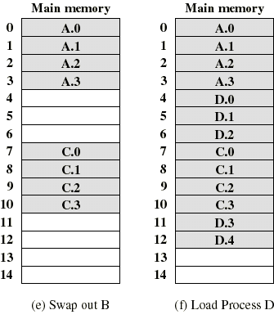
Example (continued)
Now, when B finishes or is swapped out a new process (D) can be loaded.
D needs 5 pages; it would not fit into either of the available free chunks, but with paging, we can accommodate it.

Slide 56
Address Translation
Critical issue: How can we map (translate) logical addresses to physical
In partitioned memory systems,
physical address = relative addr.+ start addr.
Starting address is stored in a base register.
The hardware performs the translation.

Slide 57
Structures for Address Translation
In paging, hardware still does translation, but a single base register isn’t enough.
Since each page in the process address space might be loaded into a separate page frame, we need something equivalent to a base register for each page in the process.
A page table is the data structure that will be used for this purpose.

Slide 58
Page Tables
The page table is an array (stored in kernel space).
  Each entry represents a page in the address space of a process (entry 0 represents page 0, entry 1 represents page 1, etc.)
  The contents of each entry will be the frame number where that page is stored, or a null entry if the page isn’t in memory (+ other data).

Slide 59
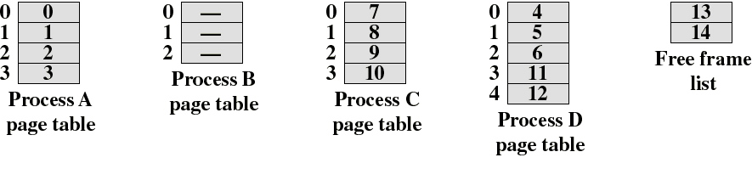
Page Tables – A Simple Example
The page tables above are based on the loading example earlier. Each process has a page table.
Notice that the page table is indexed by the page number: page 0 of process A is stored in frame 0; B is swapped out so its table has null entries.
A free frame list is maintained so new processes can be assigned to memory.

Slide 60
Address Translation in Paging
In a paged system, mapping is done on a page-by-page basis. In partitioned systems it’s done on a process-by-process basis.
The hardware must be able to extract two pieces of data from the logical address:
  a logical page number
  an offset within the page. (The offset is like a relative address within the page.)

Slide 61
Steps in Address Translation
Extract the logical page number from the logical address.
Use the page to index into the page table and retrieve the frame number where the page is stored.
Concatenate page number and offset to get physical address.

Slide 62
Address Translation
For this to work, the compiler must be able to assign logical addresses that can be used by the hardware to determine page number and offset.
That is, the logical address should be a two-part value, (p,d), where p is the logical page number and d is an offset, or displacement, within the page.

Slide 63
Logical Addresses
This is easily done by requiring the size of a page (and the size of a frame) to be a power of two.
Now, the relative address (defined relative to the origin of the program) and the logical address (p,d) will be the same.
To try to understand this, consider an analogy to decimal numbering.

Slide 64
Address Translation
Base 10 Example
Suppose a computer uses decimal (power of 10) addressing instead of binary. Let page & frame size be 100, with addresses in the range 0000-9999.
  Frame 0 has start address 0000; frame 1 has start address 0100 and so on.
  Logical address 7324 can easily be divided into two parts: page number =73, offset=24.
  If logical page 73 is loaded into frame 1, logical address 7324 maps into physical address 0124.

Slide 65
CAUTION
The previous example was just an analogy – there are no computers with power-of-ten addressing systems.

Slide 66
Address Translation
The decimal example works because the logical address can be easily divided into page-number and displacement fields, since each digit represents a power of 10.
Binary addresses can also be divided into page-number and displacement fields, where each digit represents a power of 2.

Slide 67
Logical Address Example
Assume an addressing scheme that uses 16-bit addresses and has a page size of 1K (1024 = 2¹⁰).
  We’ll need 10 bits for the displacement.
  Now there are 6 bits left for the page number, so our hypothetical computer has 2⁶ = 64 pages.
  A process 2700 bytes long will occupy three pages, with fragmentation of 372 bytes in the last page.

Slide 68
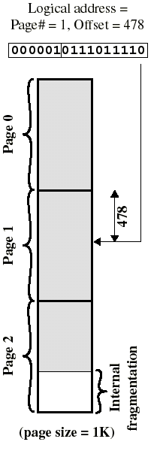
Example
Consider relative address 1502. It is located on logical page 1, at offset 478. (p, d) = 1,478.
The binary representation of 1502 is 0000010111011110.
Divide this into a six-bit page number field: 000001 = 1
and a 10-bit displacement field: 0111011110 = 478.
When the MM hardware is presented with a binary address it can easily get the two fields.

Slide 69
Generalized Address Translation
Page size is determined by the hardware. It is typically no smaller than 512 bytes and may be as large as 8K.
In general, an n + m bit address represents an n-bit page number field and an m-bit offset (displacement) field.
The MMU (Memory Management Unit) of the hardware can be designed to implement address translation automatically.

Slide 70
Generalized Address Translation
  Extract the leftmost n bits of the relative address to get the page number, p.
  Use the page number as an index into the page table and get the frame number, k, which has start address k x 2^{m}. (rightmost m bits are zero)
  The physical address is now k x 2^{m} + d. The physical address can be obtained directly by concatenating the frame number and the offset - no need to multiply and add.

Slide 71
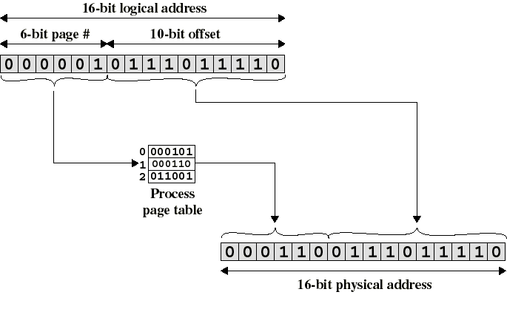
Paged Address Translation
(Notice that only the
page# field changes)

Slide 72
Page Table Register (PTR)
How does the MMU know where to find the page table for a given process?
Most architectures have a special register for this purpose. When a process is dispatched (put into the Run state), the start address of its page table is loaded into the PTR as part of the process switch.

Slide 73
Simple Segmentation
Segmentation also divides the process address space into chunks, now called segments.
Segments are based on logical, not physical, characteristics of the program. One segment might contain the main program, others a group of related functions, etc.
Each segment can be a different size.

Slide 74
Segmentation
In theory, a segment is allocated just as much space as it needs, similar to dynamic partitioning. No internal fragmentation, but possible external fragmentation.
In practice, segments are usually a power of two, to simplify allocation - thus some amount of internal fragmentation exists.
Logical addresses are expressed as (s, d): segment number and offset into segment.

Slide 75
Address Translation in Segmentation
Similar to simple paging - for example, there is a segment table, which specifies
  start address of each segment
  segment length
The hardware uses the segment number as an index into the segment table.
Segment start address + displacement = physical address.

Slide 76
Address Translation Remarks
(mostly about paging)
Address translation is transparent to the user.
The OS is responsible for finding enough free frames for a process and for creating and initializing the page table.
Protection is provided by the page table. If the referenced page isn’t part of the process address space, the PT entry will be null.

Slide 77
Memory Allocation in Paging
Paging dramatically simplifies allocation.
The frame table is structure that many operating systems use to support allocation.
The frame table has an entry for each frame in memory. The entry tells whether the corresponding frame is empty or allocated, and if allocated, to which process.

Slide 78
Paging: Pros and Cons
Paging minimizes fragmentation.
It lets processes share memory by putting pointers to the same physical frames in each process’s page table.
Loss of execution speed due to extra memory references for address translation.
Loss of memory space to page table storage.

Slide 79
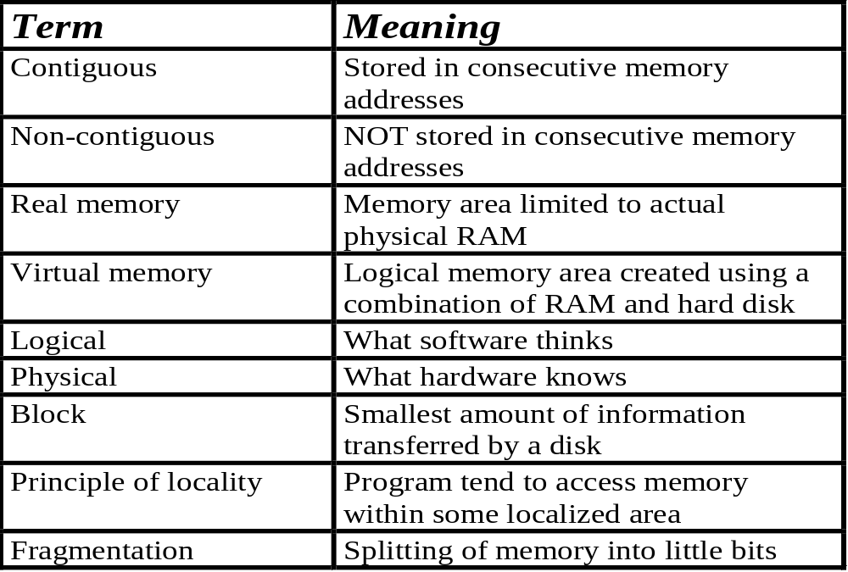
Important Memory Terms
Ceng 334 - Operating Systems
3.1-<number>

